Slide 1
Examples for lectures
Mobile Communications 2019
Notes:
1

Slide 2
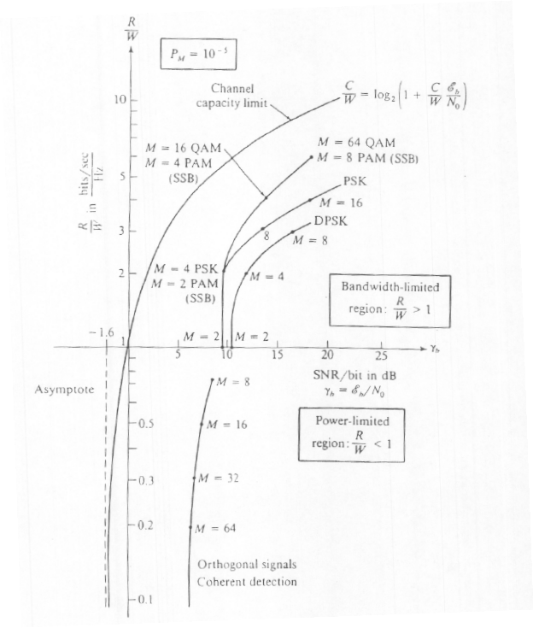
Comparison of modulation techniques

Slide 3
Example 1
With the aid of the graph given in the figure indicating the performance of various digital modulation schemes operating in an (AWGN) channel with an error rate of 10⁻⁵, select suitable modulation schemes in order to meet the following criteria.
 | System A | System B
Data Rate at BER < 10⁻⁵ | 1000bit/s | 100kbit/s
Channel Bandwidth | 500Hz | 25kHz
E_{b}/N_{o} | <12dB | <25dB

Slide 4
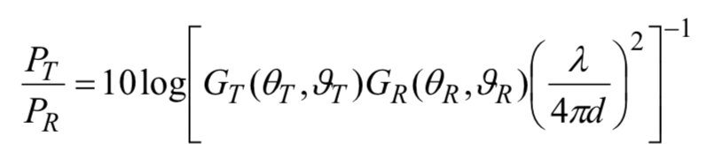


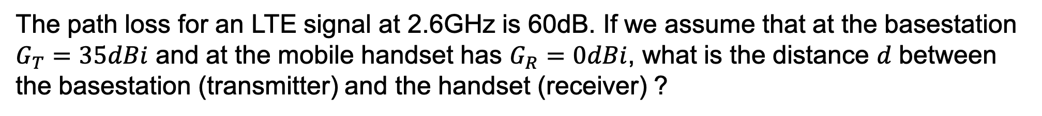
Example 2
The path loss for an LTE signal at 2.6GHz is 60dB. If we assume that at the basestation $G_{T}=35dBi$ and at the mobile handset has $G_{R}=0dBi$, what is the distance $d$ between the basestation (transmitter) and the handset (receiver) ?
$$PL=20\log\left(d\right)+20\log\left(f\right)+20\log\left(\frac{4π}{c}\right)−10logG_{R}−10logG_{T}$$
$$λ=c/f$$
$$60=20\log\left(d\right)+20\log\left(2.6×{10}^{9}\right)+20\log\left(\frac{4π}{3×{10}^{8}}\right)−0−35$$
$$60=20\log\left(d\right)+20\log\left(2.6×{10}^{9}\right)+20\log\left(4.18×{10}^{8}\right)−0−35$$
$$60=20\log\left(d\right)+188.3−147.5−35$$
$$60=20\log\left(d\right)+5.8$$
$$20\log\left(d\right)=54.2$$
$$\log\left(d\right)=2.71$$
$$d={10}^{2.71}=512 .8 m$$

Slide 5
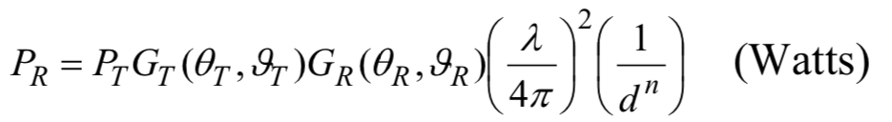

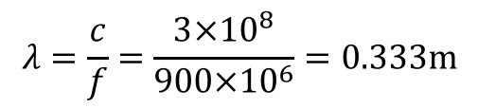
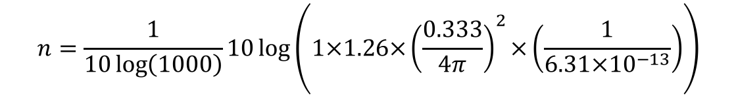
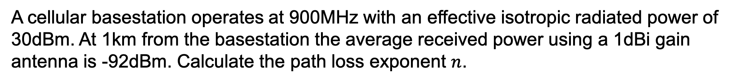

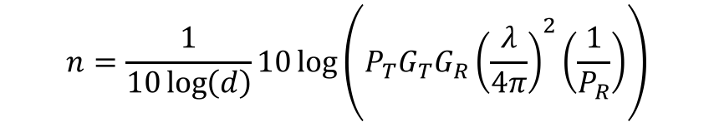
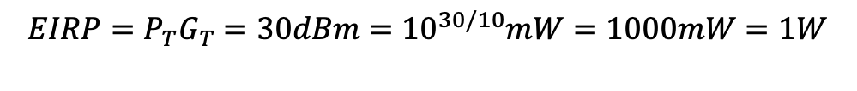
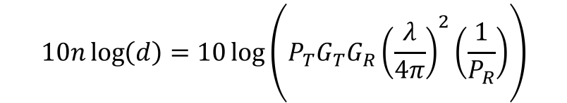
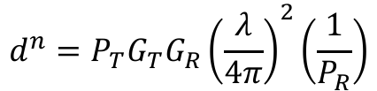
Example 3
A cellular basestation operates at 900MHz with an effective isotropic radiated power of 30dBm. At 1km from the basestation the average received power using a 1dBi gain antenna is -92dBm. Calculate the path loss exponent $n$.
$$EIRP=P_{T}G_{T}=30dBm={10}^{30/10}mW=1000mW=1W$$
$$G_{R}=1dBi={10}^{1/10}=1.26$$
$$λ=\frac{c}{f}=\frac{3×{10}^{8}}{900×{10}^{6}}=0.333m$$
$$P_{R}=−92dBm={10}^{−\frac{92}{10}}mW=6.31×{10}^{−10}mW=6.31×{10}^{−13}W$$
$$n=\frac{1}{10\log\left(d\right)}10\log\left(P_{T}G_{T}G_{R}{\left(\frac{λ}{4π}\right)}^{2}\left(\frac{1}{P_{R}}\right)\right)$$
$P_{R}=P_{T}G_{T}G_{R}{\left(\frac{λ}{4π}\right)}^{2}$ $\left(\frac{1}{d^{n}}\right)$
$$d^{n}=P_{T}G_{T}G_{R}{\left(\frac{λ}{4π}\right)}^{2}\left(\frac{1}{P_{R}}\right)$$
$$n=\frac{1}{10\log\left(1000\right)}10\log\left(1×1.26×{\left(\frac{0.333}{4π}\right)}^{2}×\left(\frac{1}{6.31×{10}^{−13}}\right)\right)$$
$$10n\log\left(d\right)=10\log\left(P_{T}G_{T}G_{R}{\left(\frac{λ}{4π}\right)}^{2}\left(\frac{1}{P_{R}}\right)\right)$$
$$n≈3.05$$

Slide 6
Example 4
An LTE basestation, operating at 2.6GHz, transmits a signal at a mobile handset at a distance of 700m. The antenna gain at the transmitter is 35dBi and at the mobile handset 0dBi. Calculate the path loss assuming a LoS link.
$$PL=10log{\left(G_{R}G_{T}{\left(\frac{λ}{4πd}\right)}^{2}\right)}^{−1}=10log{\left(G_{R}G_{T}{\left(\frac{c}{4πdf}\right)}^{2}\right)}^{−1}$$
$$PL=20\log\left(d\right)+20\log\left(f\right)+20\log\left(\frac{4π}{c}\right)−10logG_{R}−10logG_{T}$$
$$PL=20\log\left(700\right)+20\log\left(2.6×{10}^{9}\right)+20\log\left(\frac{4π}{3×{10}^{8}}\right)−0−35$$
$$PL=56.9+188.3−147.5−35$$
$$PL=62.7dB$$

Slide 7
Question
If we have a non LoS link, and therefore shadowing, how would the previous Path Loss equation change?
$$PL=10log{\left(G_{R}G_{T}{\left(\frac{λ}{4π}\right)}^{2}\frac{1}{d^{n}}\right)}^{−1}=10log{\left(G_{R}G_{T}{\left(\frac{c}{4πf}\right)}^{2}\frac{1}{d^{n}}\right)}^{−1}$$
$$PL=10n\log\left(d\right)+20\log\left(f\right)+20\log\left(\frac{4π}{c}\right)−10logG_{R}−10logG_{T}$$

